Slide 1
Modern Cryptography: Encryption and Much More...
Shai Halevi, IBM T.J. Watson Research Center

Slide 2

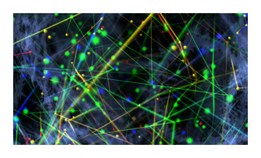
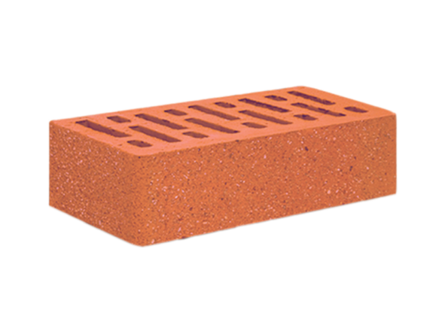

Three (related) topics
2. Protecting Data in Processing
main focus
3. Blockchain
1. Quantum-Safe Cryptography

Slide 3
Quantum Safe Cryptography

Slide 4
Quantum Safe Cryptography
A working quantum computer?
Certailny not today or tomorrow
But progress is made all the time
Maybe in 10, 20, 30 years?
If ever built, a qauntum computer could break much of today's cryptography
E.g., it can factor large integers, thus breaking the RSA cryptosystem
It is prudent to start preparing

Slide 5
Lattice-Based Cryptography
A well-developed branch of cryptography
Based on very different problems than factoring
Believed to be hard even for quantum computers
Known lattice-based methods for public key encryption, signatures, key-exchange, etc.
Implemented in software libraries
In the process of standardization
A good option for quantum-safe cryptography

Slide 6
2. Protecting Data in Processing

Slide 7
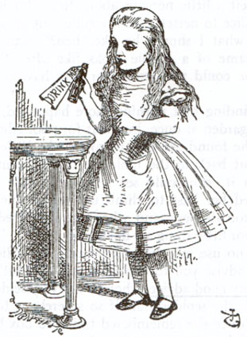


Traditional Cryptography: Securing Communication
Replicate in the digital world the functionality of sealed envelopes/Brinks cars
Bob
Alice
IHlBaf8ZK1i
l1xqqo1M4
0ZNAdMyV
Hello
there
Hello
there
Decrypt
Encrypt

Slide 8






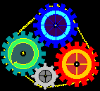





Modern Cryptography is Much More
Need to protect data even as it is being processed
The Wonderful Cloud
not so

Slide 9
Protecting Data in Processing
Two main flavors:
Private outsourcing: weak data owner, strong worker (cloud)
Owner encrypts data, worker learns nothing
Use of homomorphic encryption (FHE)
Typically non-interactive (or minimally interactive)
Private cooperation: many mutually-suspicious data owners
Each with its own secret data, want to compute aggregate functions
Interactive, use of secure-multiparty computation (MPC)

Slide 10

Homomorphic Encryption for Outsourcing
Data can be processed in encrypted form
Result is also encrypted
Enc(x)
f
Enc[ f(x)]
Client
Server/Cloud
(Input: x)
(Function: f )

Slide 11

Homomorphic Encryption for Outsourcing
Data can be processed in encrypted form
Result is also encrypted
Example: location services
I encrypt my location, send to Yelp
Yelp compute an encrypted table lookup
T[cityBlock#] = reviews for nearby coffee shops
I get back encrypted recommendation for coffee shops within two blocks

Slide 12
Realizing Homomorphic Encryption
The same lattice-based encryption
So also qauntum safe
But with much larger keys
Makes performence challenging
Drastic improvement in performence over the years
Moore’s law
Estimated amortized time for computing a single bit operation on encrypted data
2010
2011
2012
2013
2014

Slide 13




Secure MPC for Cooperation
We all have our individual secrets
We can compute a function of these secrets
Without revealing them to each other (or anyone else)
x₁
x₂
Goal:
Correctness: Everyone computes y = f (x₁,…,x_{n})
Privacy: Nothing but the output is revealed
x₃
x₄

Slide 14



Example: No-Fly-List Using 2PC
Police has a list of suspects
Airline has a list of passengers
Output is the intersection of the two lists

Slide 15

Realizing Secure MPC
Ongoing research over the last 30 years
Multiple techniques, many implementations
There is an adequate solution for almost any task
Although designing it may take a team of experts

Slide 16
Blockchains

Slide 17

Blockchain Basics
Blockchain = a distributed system for “agreeing on things”
A public append-only file, everyone sees the same file
The “things that we agree on” are called transactions
Application logic determines what it a transaction
E.g. moving currency between accounts, shipping items, etc.
How to store & use private data on a blockchain?
Even though everyone sees the same file?

Slide 18


Private Data on a Blockchain
Private data is stored encrypted
Under a key of the “data owner”
Everyone sees the same ledger
Only I can decrypt my private data
But how to use the encrypted data?
Use secure MPC (and zero-knowledge)
Let us compute on the private data without seeing it

Slide 19
Summary
Quantum-safe cryptography is available
Now is a good time to experiment with it, start planning for a transition
Data needs protection even in processing
Cryptographic techniques are available
Many are in transition from the lab to the field
These techniques are also useful in blockchains

Slide 20
Thank you!

Slide 21

Implementations
Lattice-Based Cryptography: The CRYSTALS library at https://pq-crystals.org/
KYBER for public-key encryption
Dilithium for digital signatures
Homomorphic Encryption: The HElib library at https://github.com/shaih/HElib
Still a research prototype

